Slide 1
Combinational Logic
Chapter 4e
Imran Siddiqi
imran.siddiqi@mcs.edu.pk
Computer Science Department
College of Telecommunication Engineering
National University of Sciences and Technology

Slide 2
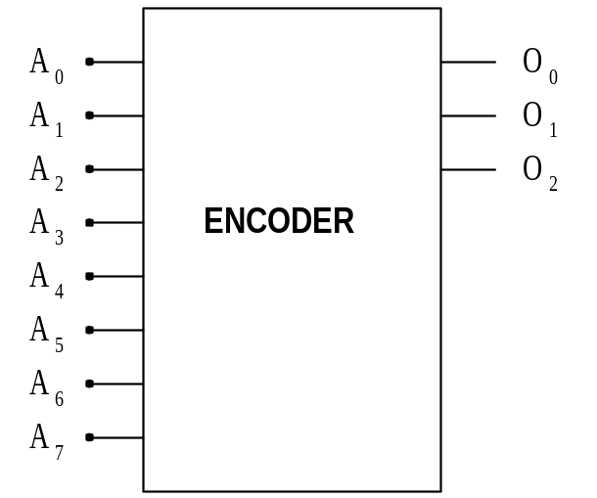
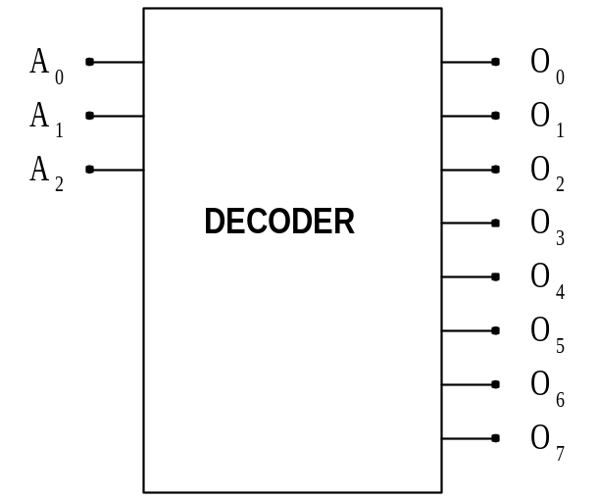
ENCODERS AND DECODERS
ONLY ONE INPUT ACTIVATED AT A TIME
BINARY CODE INPUT
ONLY ONE OUTPUT ACTIVATED AT A TIME
BINARY CODE OUTPUT

Slide 3
Contents
Encoders
Priority Encoder
Multiplexers
Implementing functions with Multiplexers

Slide 4
Encoders
Encoding - the opposite of decoding
Circuits that perform encoding are called encoders
An encoder has 2^{n} (or fewer) input lines and n output lines which generate the binary code corresponding to the input values
Typically, an encoder converts a code containing exactly one bit that is 1 to a binary code corresponding to the position in which the 1 appears.

Slide 5
Encoders
Encoder: translates 2^{n} input lines into n output lines
  Input: 2^{n} lines
  Output: n bits
  Output is binary coding of input that is 1

Slide 6
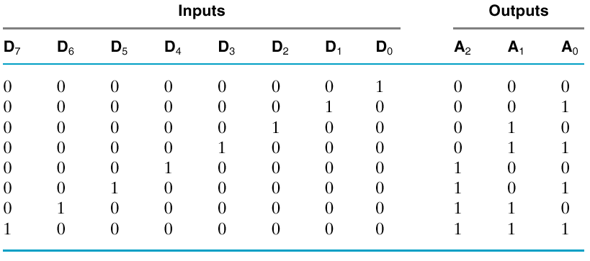
Encoder – Truth Table

Slide 7
Encoders
Inputs are Minterms
Can OR them together appropriately
A₀ = D₁ + D₃ + D₅ + D₇

Slide 8
Encoders
A₀ = D₁ + D₃ + D₅ + D₇
A₁ = D₂ + D₃ + D₆ + D₇
A₂ = D₄ + D₅ + D₆ + D₇

Slide 9
Encoders
Problem
  What if D3 and D6 both high?
  Simple OR circuit will set A to 7

Slide 10

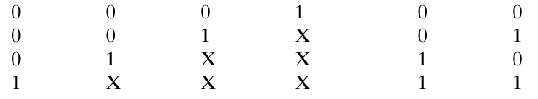
Priority Encoder
Chooses one with highest priority
  Largest number, usually
What if all inputs are zero?

Slide 11
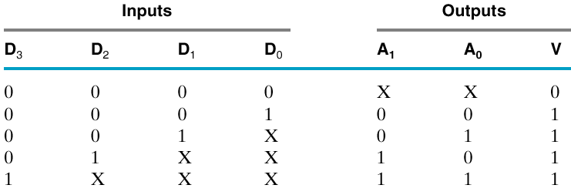
Priority Encoder
Add another output

Slide 12
Priority Encoder
D₁D₀
 | 00 | 01 | 11 | 10
00 | x | 0 | 0 | 0
01 | 1 | 1 | 1 | 1
00 | 1 | 1 | 1 | 1
10 | 1 | 1 | 1 | 1
D₃D₂
For A₁
A₁=D₂+D₃

Slide 13
Priority Encoder
D₁D₀
 | 00 | 01 | 11 | 10
00 | x | 0 | 1 | 1
01 | 0 | 0 | 0 | 0
11 | 1 | 1 | 1 | 1
10 | 1 | 1 | 1 | 1
D₃D₂
For A₀
A₀=D₃ + D₁D₂’

Slide 14
Priority Encoder
D₁D₀
 | 00 | 01 | 11 | 10
00 | 0 | 1 | 1 | 1
01 | 1 | 1 | 1 | 1
00 | 1 | 1 | 1 | 1
10 | 1 | 1 | 1 | 1
D₃D₂
For V
V=D₀+D₁+D₂+D₃

Slide 15
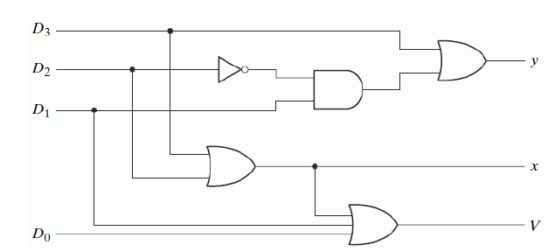
Priority Encoder
Circuit Diagram
x = D2 + D3
y = D3 + D1 D2’
V = D0 + D1 + D2 + D3

Slide 16
Multiplexer
A multiplexer (MUX) selects one of multiple input signals and passes it to the output.

Slide 17
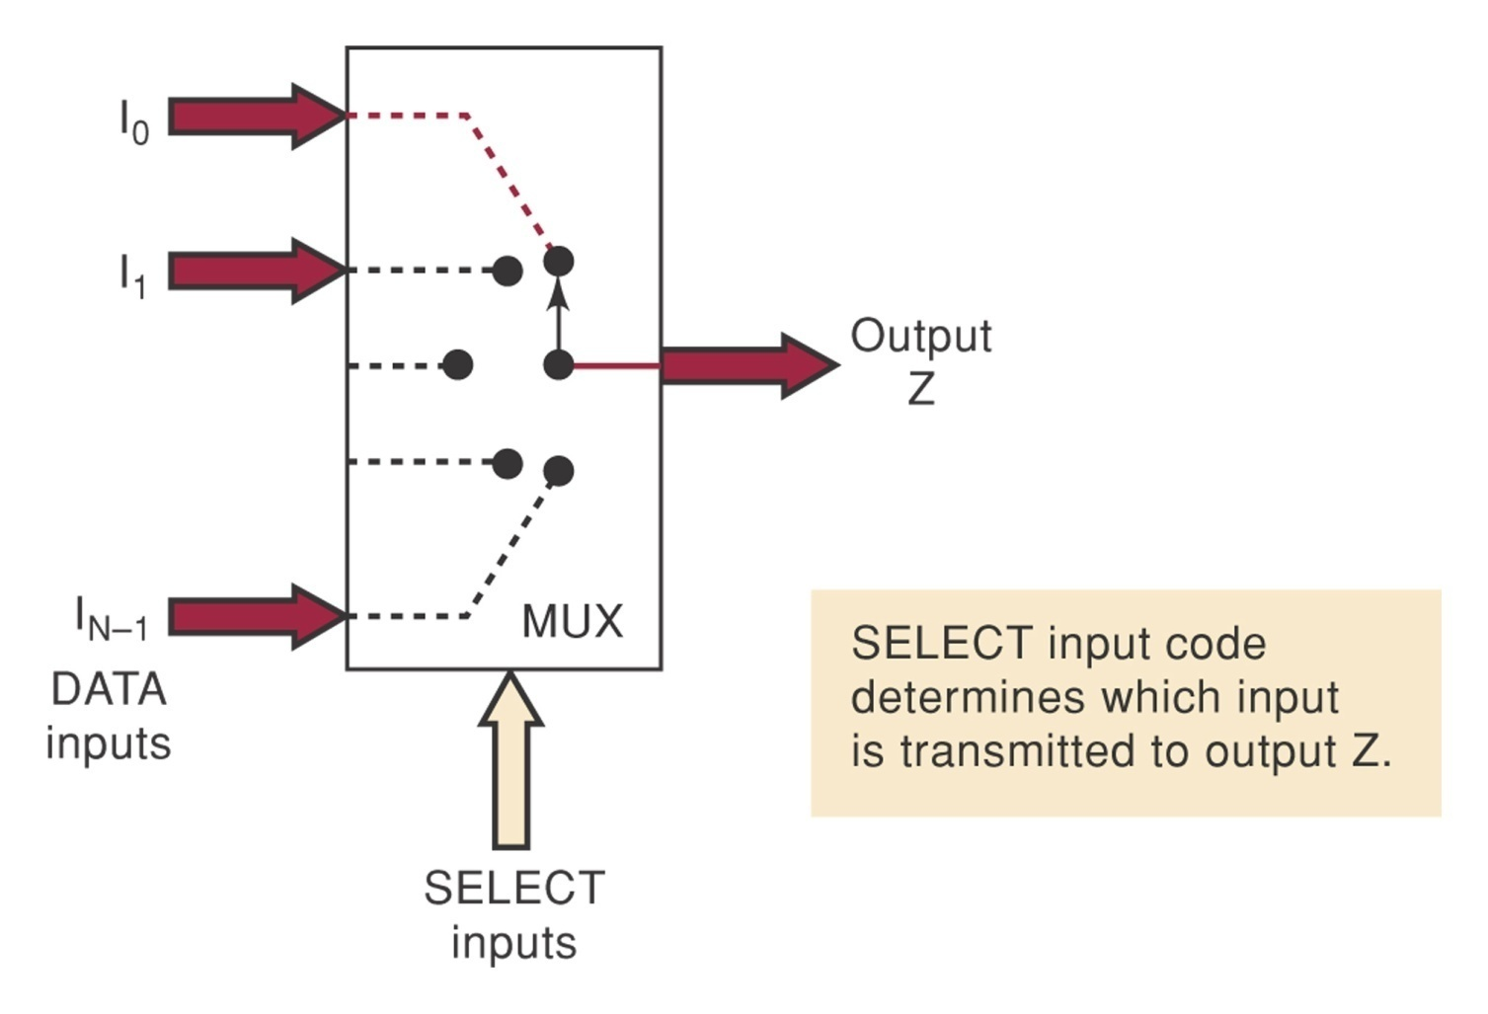
Multiplexer (Data Selector)
Selects one of a set of inputs to pass on to output
Binary control code, n lines - Choose from 2^{n} inputs

Slide 18
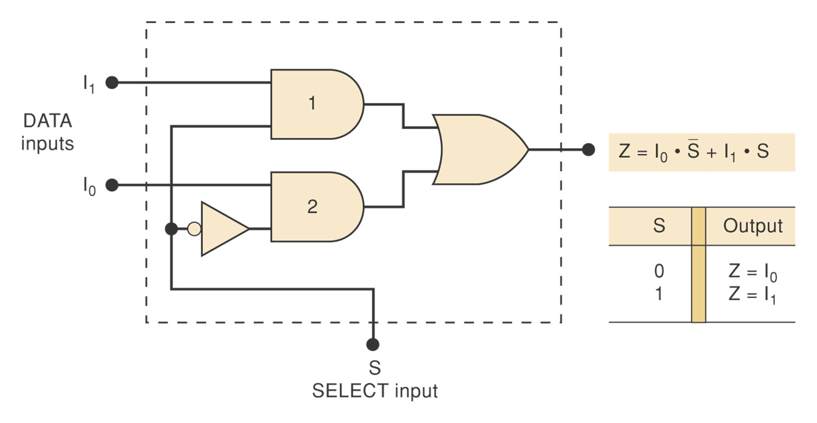
2-To-1 Line MUX

Slide 19
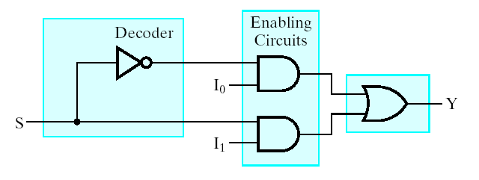
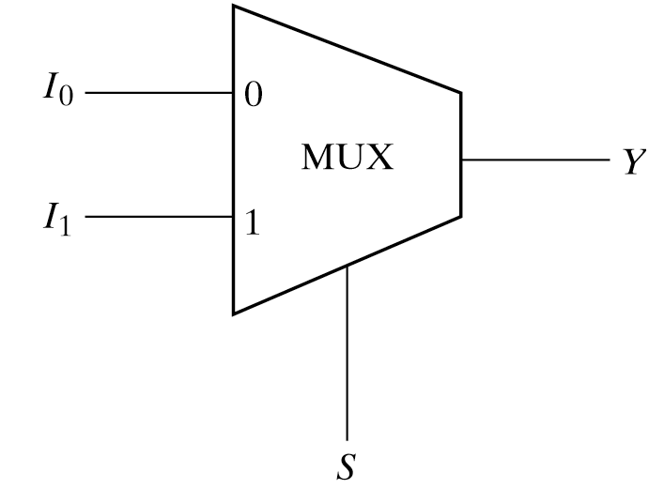
2-To-1 Line MUX

Slide 20
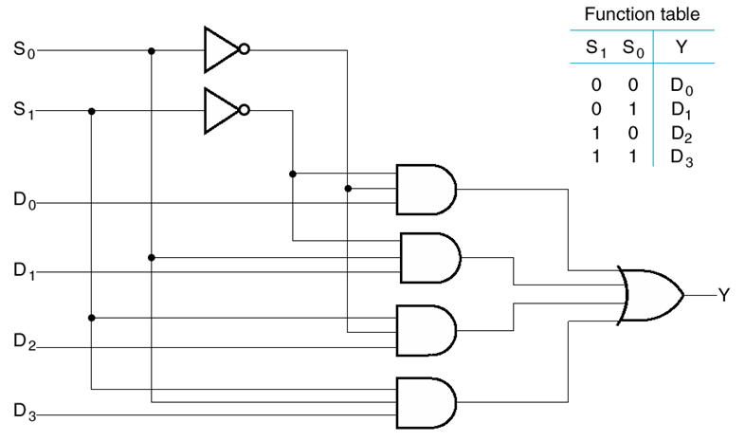
4-to-1 line MUX

Slide 21
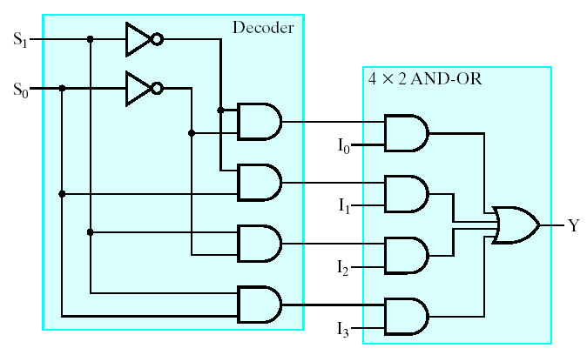
4-to-1 line MUX

Slide 22

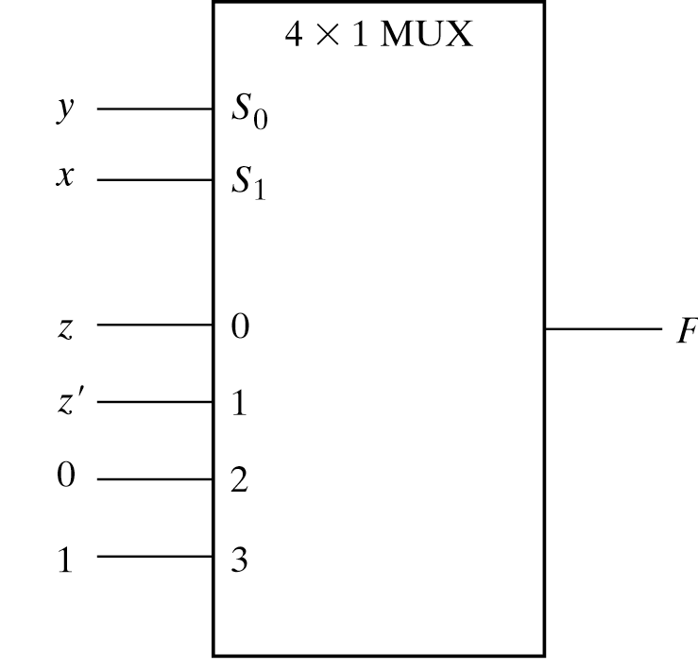
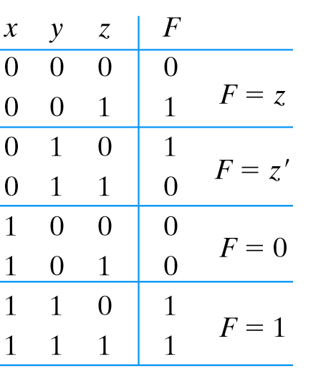
Function implementation using multiplexer
Function with n variables and multiplexer with n – 1 selection lines

Slide 23
Function implementation using multiplexer
Complete the truth table from the SOP.
2. The first n – 1 variables in the table are applied to the selection inputs of the multiplexer.
3. For each combination of the selection variables, we evaluate the output as a function of the last variable.
4. Apply these values to the data input in proper order.

Slide 24
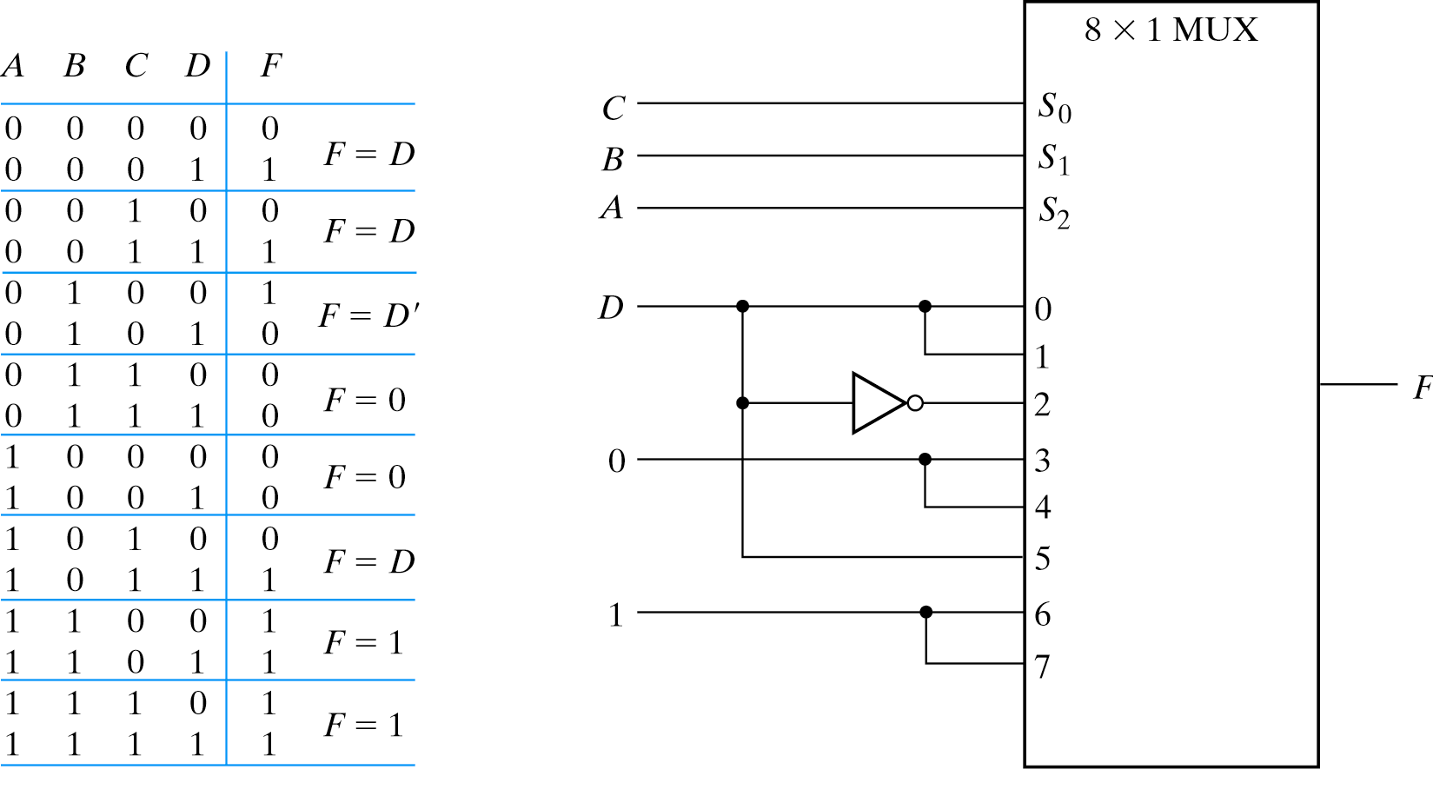
Function implementation
Note the order of input lines

Slide 25
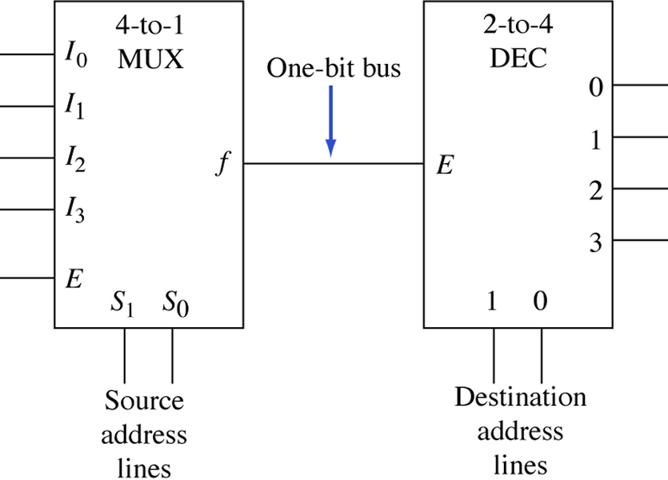
A multiplexer/demultiplexer arrangement for information transmission

Slide 26
Assignment # 3

Slide 27
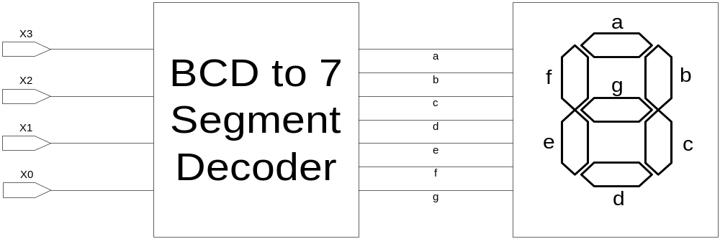
BCD to 7 Segment Display
Design the logic circuitry that will drive a seven segment LED display and will be able to represent numbers from 0 to 9

Slide 28
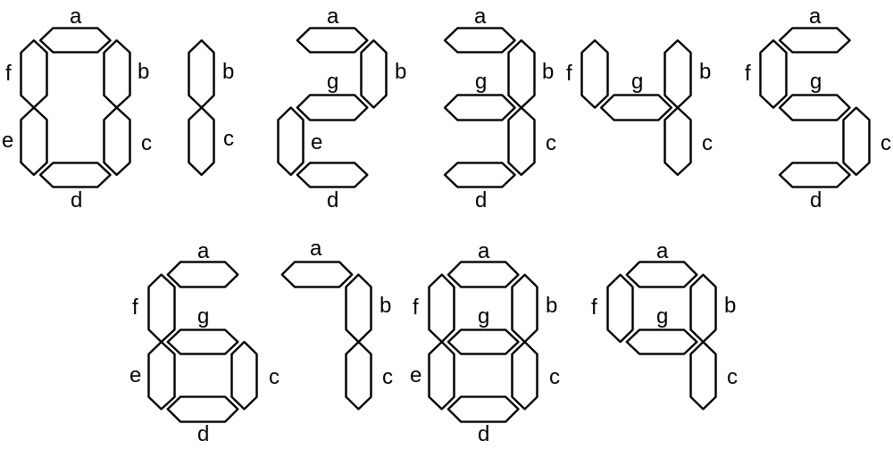
Possible numbers and their representation on 7 segment display

Slide 29
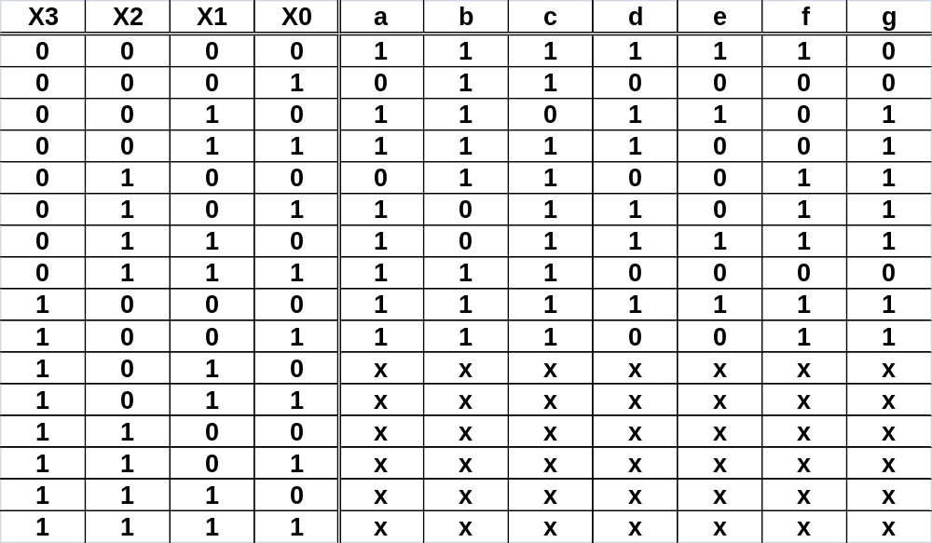
Truth Table

Slide 30


Find simplified expression for each of the output variables.
Design the corresponding circuits.

Slide 31
References
Chapter 4 – Digital Design Morris Mano
Logic and Computer Design Fundamentals, 4e, Power Point Slides, 2008 Pearson Education Inc.
Digital Design – Amirali Baniasadi
Material in these slides has been taken from, the following resources

